Slide 1


CAPSTONE PROJECT
ADIENCESOUND
RECOMMENDATION SYSTEM
PREPARED BY: CLIFTON LEE

Slide 2

PRESENTER'S INTRODUCTION
Microsoft Certified Data Professional
Over 5 years of experience in the field of Data
Candidate for UWI's MSc Applied Data Science

Slide 3

BUSINESS CASE
PROBLEM
OBJECTIVES
CRISP DM
STAGES
APPROACH
Q & A
QUESTIONS
ANSWERS

Slide 4

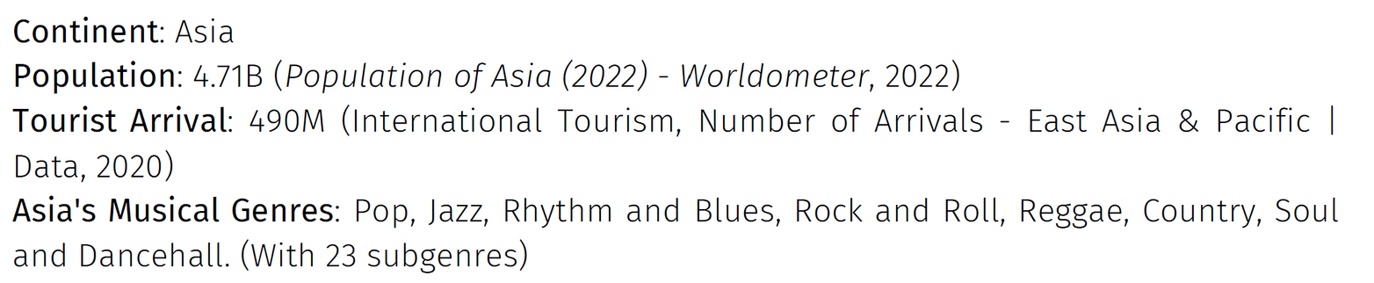
BUSINESS CASE / DOMAIN
BACKGROUND & CASE PROBLEM

Slide 5
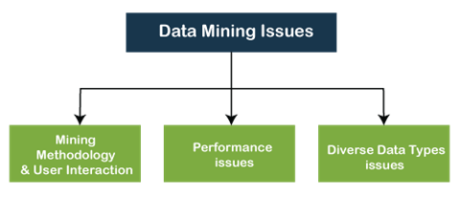
BUSINESS CASE / DOMAIN
DATA MINING CHALLENGES

Slide 6

BUSINESS CASE / DOMAIN
OBJECTIVES
Highlight a traveler's problem
Provide a Business Solution
Acknowledge some Asia's outstanding artist

Slide 7
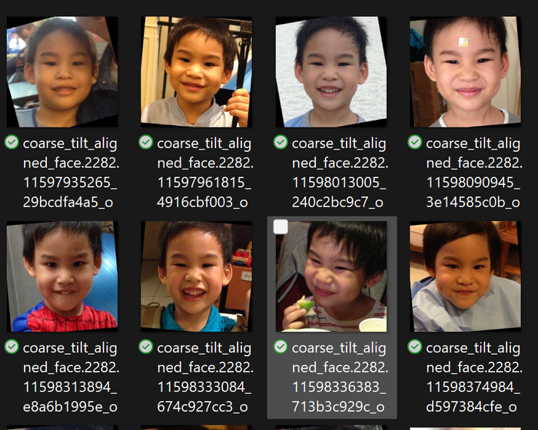
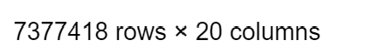
CRISP-DM
DATA UNDERSTANDING
- ADIENCE DATASET (26580 IMAGES, 2284 PARTICIPANTS)
- KKBOX DATASET (7.8 MILLION RECORDS)

Slide 8
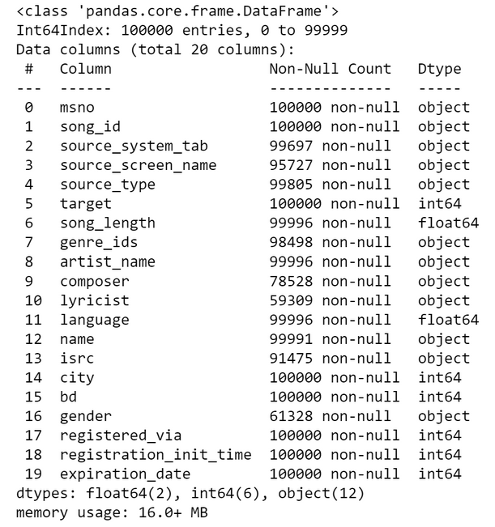
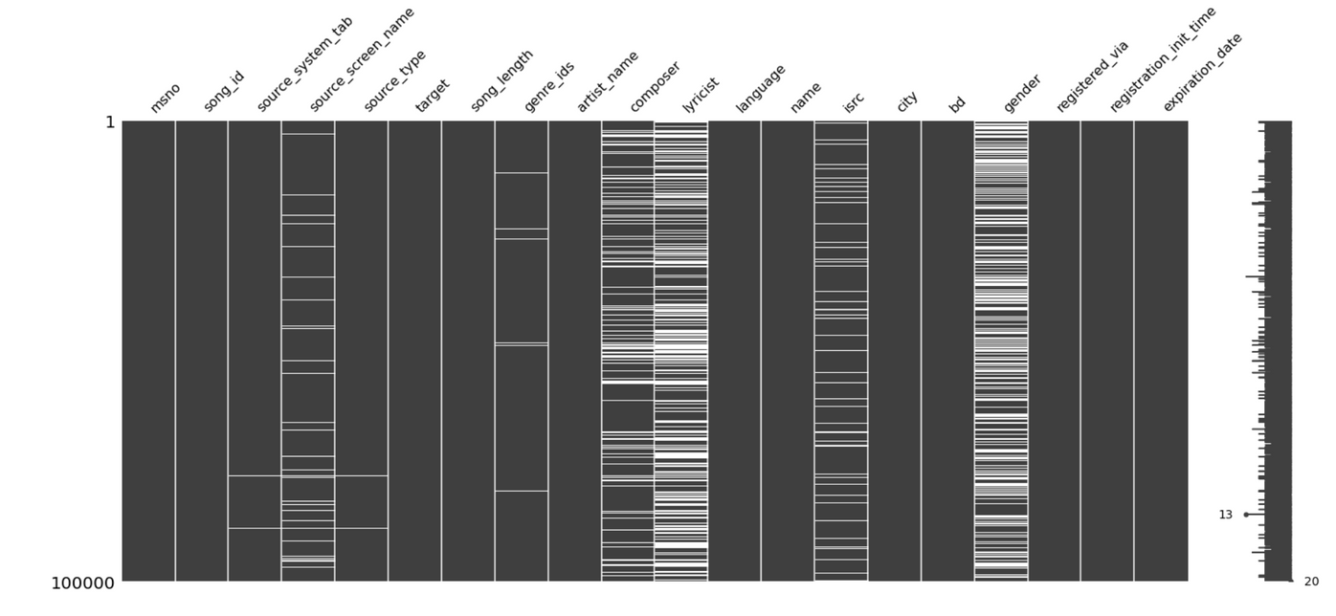
CRISP-DM
DATA PREPARATION

Slide 9
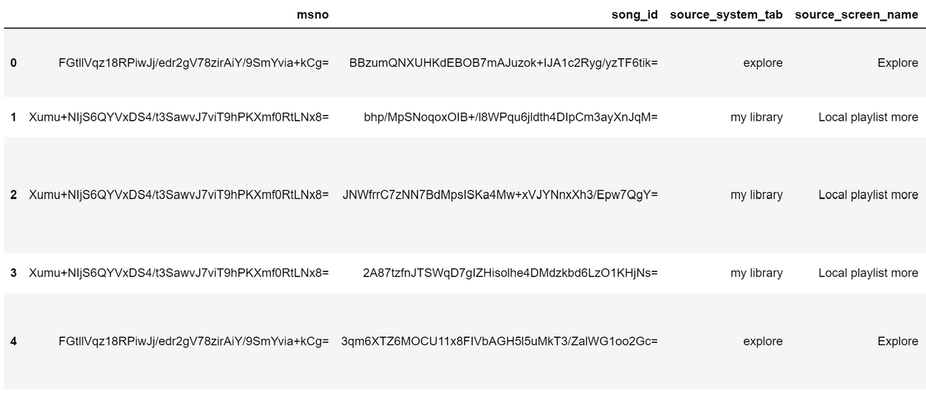

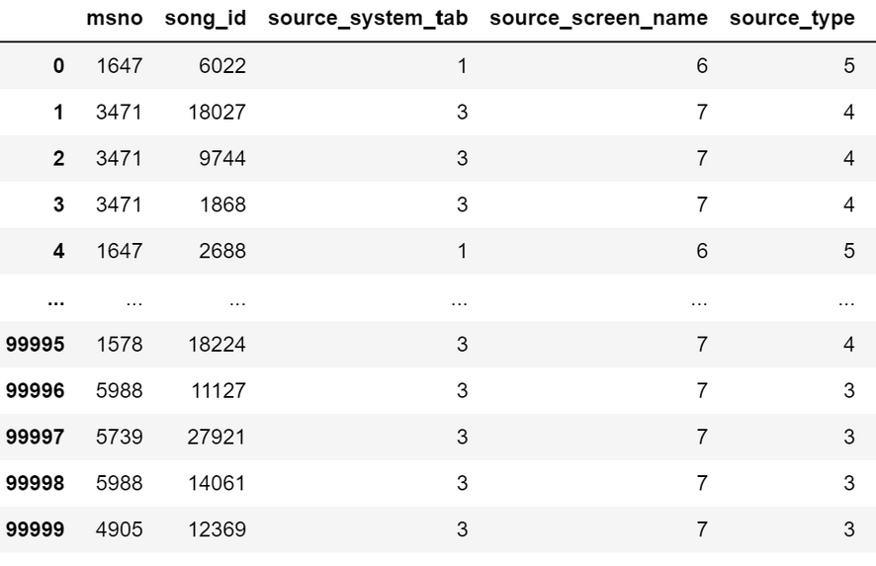

Slide 10
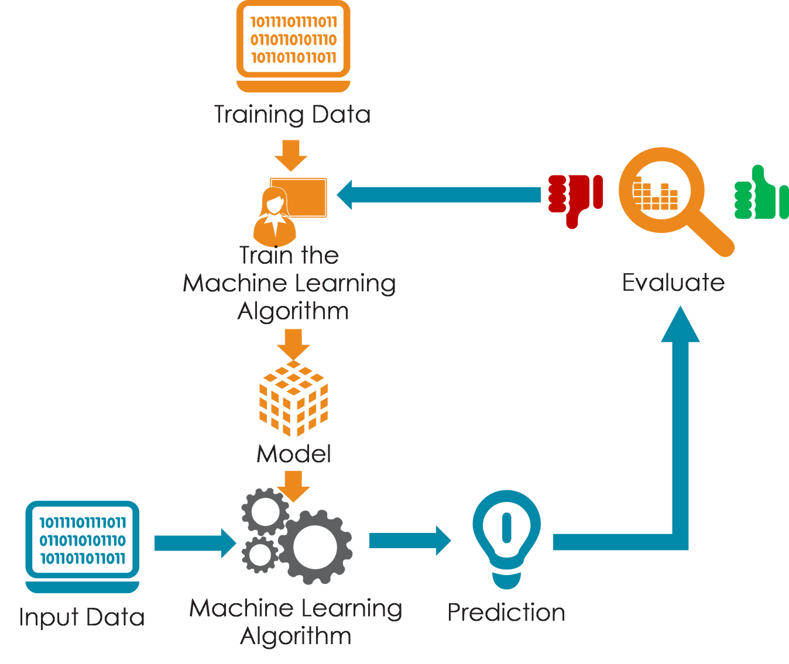
MODELS & RESULTS
1
UNSTRUCTURED DATA ALGORITHMS
EIGENFACES, FISHER FACES & CNNs.
Result: CNNs
2
STRUCTURED DATA ALGORITHMS
KNN, DECISION TREES, LOGISTICS REGRESSION.
Result: DECISION TREES
3
MODEL-BASED COLLABORATIVE FILTERING

Slide 11
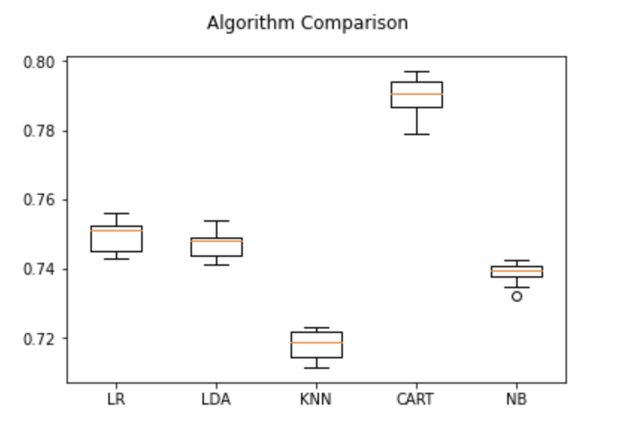
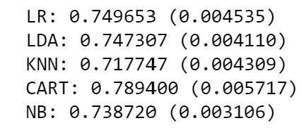
EVALUATION

Slide 12


DEPLOYMENT

Slide 13
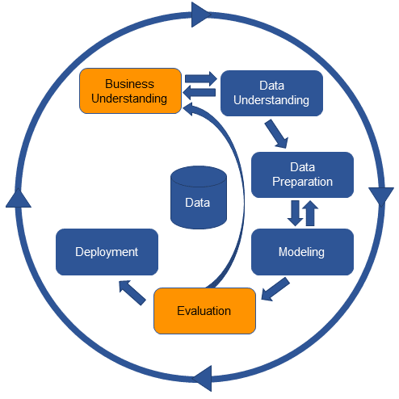
CONCLUSION

